Slide 1

Inverse Kinematic Solutions with Paden-Kahan SubProblems for a Specified Robotic Platform
KERİM MORAL
518191043
KOM 513E – Modelling and Control of Robots
Prof. Dr. Hakan TEMELTAŞ

Slide 2

Introduction

Slide 3
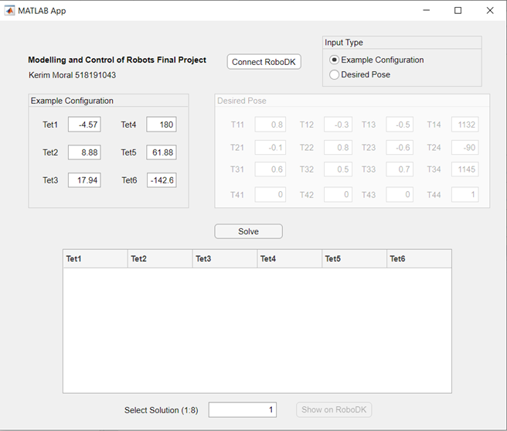
Introduction

Slide 4


2. Calculation of Inverse Kinematics
$Td= e^{\left[S1\right]θ_{1d}}e^{\left[S2\right]θ_{2d}}e^{\left[S3\right]θ_{3d}}e^{\left[S4\right]θ_{4d}}e^{\left[S5\right]θ_{5d}}.M$

Slide 5
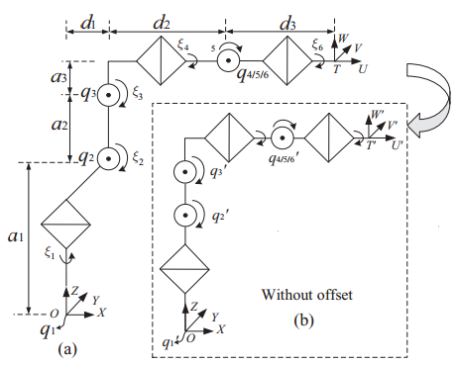
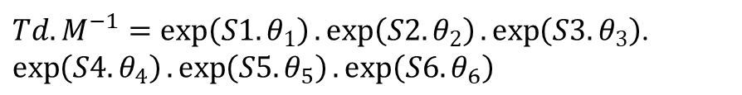


2. Calculation of Inverse Kinematics
$Td.M^{−1}=\exp\left(S1.θ_{1}\right).\exp\left(S2.θ_{2}\right).\exp\left(S3.θ_{3}\right)$. $\exp\left(S4.θ_{4}\right).\exp\left(S5.θ_{5}\right).\exp\left(S6.θ_{6}\right)$
$$\overline{q_{4,5,6}}.\exp\left(S4.θ_{4}\right).\exp\left(S5.θ_{5}\right).\exp\left(S6.θ_{6}\right)=.\overline{q_{4,5,6}}$$
$$Td.M^{−1}.\overline{q_{4,5,6}}=\exp\left(S1.θ_{1}\right).\exp\left(S2.θ_{2}\right).\exp\left(S3.θ_{3}\right).\overline{q_{4,5,6}}$$
$$p_{1}=Td.M^{−1}.\overline{q_{4,5,6}}$$
$θ_{1}=atan2(±{p_{1}}_{y},±{p_{1}}_{x})$

Slide 6
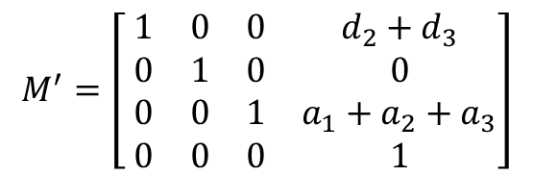
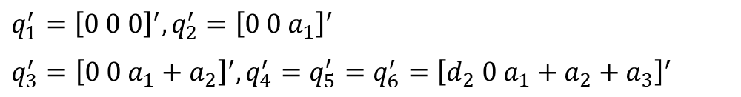
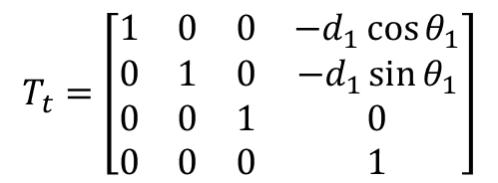
2. Calculation of Inverse Kinematics
$$T_{t}=\left[\begin{matrix}1 & 0 & 0 & −d_{1}\cos{θ_{1}} \\ 0 & 1 & 0 & −d_{1}\sin{θ_{1}} \\ 0 & 0 & 1 & 0 \\ 0 & 0 & 0 & 1\end{matrix}\right]$$
$q_{1}^{′}={\left[0 0 0\right]}^{′}, q_{2}^{′}={\left[0 0 a_{1}\right]}^{′}$
$q_{3}^{′}={\left[0 0 a_{1}+a_{2}\right]}^{′}, q_{4}^{′}=q_{5}^{′}=q_{6}^{′}={\left[d_{2} 0 a_{1}+a_{2}+a_{3}\right]}^{′}$
$$M^{′}=\left[ \begin{matrix}1 & 0 & 0 & d_{2}+d_{3} \\ 0 & 1 & 0 & 0 \\ 0 & 0 & 1 & a_{1}+a_{2}+a_{3} \\ 0 & 0 & 0 & 1\end{matrix}\right]$$

Slide 7
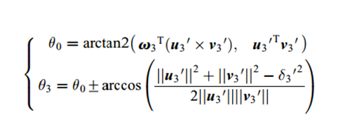


2. Calculation of Inverse Kinematics
$$Tt.Td.{M′}^{−1}.\overline{q_{4,5,6}^{′}}=\exp\left(S1.θ_{1}\right).\exp\left(S2.θ_{2}\right).\exp\left(S3.θ_{3}\right).\overline{q_{4,5,6}^{′}}$$
$$p_{2}=Tt.Td.M^{−1}.\overline{q_{4,5,6}^{′}}$$
$\exp\left(S1.θ_{1}\right).\exp\left(S2.θ_{2}\right).[exp\left(S3.θ_{3}\right).\overline{q_{4,5,6}^{′}}−\overline{q_{2}^{′}}]=\overline{p_{2}}−\overline{q_{2}^{′}}$
$$||exp\left(S3.θ_{3}\right).\overline{q_{4,5,6}^{′}}−\overline{q_{2}^{′}}||=\overline{||p_{2}}−\overline{q_{2}^{′}}||$$
Solved with PK subproblem 3

Slide 8
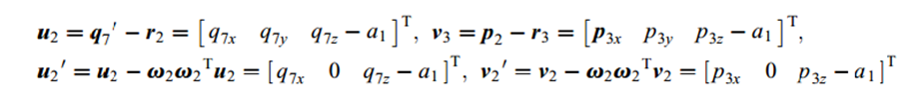




2. Calculation of Inverse Kinematics
$$\exp\left(−S1.θ_{1}\right).Tt.Td.{M′}^{−1}.\overline{q_{4,5,6}^{′}}=\exp\left(S2.θ_{2}\right).\exp\left(S3.θ_{3}\right).\overline{q_{4,5,6}^{′}}$$
$$\exp\left(−S1.θ_{1}\right).Tt.Td.M^{−1}.\overline{q_{4,5,6}^{′}}=\exp\left(S2.θ_{2}\right).\overline{q_{7}^{}}$$
Where $\overline{q_{7}^{}}= \exp\left(S3.θ_{3}\right).\overline{q_{4,5,6}^{′}}$
$p_{3}=\exp\left(−S1.θ_{1}\right).Tt.Td.M^{−1}.\overline{q_{4,5,6}^{′}}$
$$p_{3}= \exp\left(S2.θ_{2}\right).\overline{q_{7}^{}}$$
Solved with PK subproblem 1

Slide 9

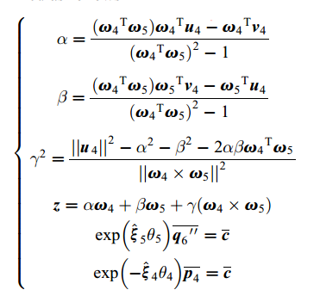


2. Calculation of Inverse Kinematics
$$\exp\left(−S3.θ_{3}\right).exp\left(−S2.θ_{2}\right).exp\left(−S1.θ_{1}\right).Tt.Td.{M′}^{−1}=\exp\left(S4.θ_{4}\right).exp\left(S5.θ_{5}\right)$$
${define q}_{6}^{′′}=[0 0 a_{1}+a_{2}+a_{3}]′$
$\exp\left(−S3.θ_{3}\right).exp\left(−S2.θ_{2}\right).exp\left(−S1.θ_{1}\right).Tt.Td.M^{−1}.q_{6}^{′′}=\exp\left(S4.θ_{4}\right).exp\left(S5.θ_{5}\right).q_{6}^{′′}$
${define p}_{4}=\exp\left(−S3.θ_{3}\right).exp\left(−S2.θ_{2}\right).exp\left(−S1.θ_{1}\right).Tt.Td.M^{−1}.q_{6}^{′′}$
Solved with PK subproblem 3

Slide 10

2. Calculation of Inverse Kinematics
$\exp\left(−S5.θ_{5}\right).exp\left(−S4.θ_{4}\right).exp\left(−S3.θ_{3}\right).exp\left(−S2.θ_{2}\right).exp\left(−S1.θ_{1}\right).Tt.Td.{M′}^{−1}.q_{8}^{}=p_{5}$
Let $q_{8}^{}$ be a point out of S6 axis where $q_{8}^{}=\left[0 0 a_{1}+a_{2}\right]′$
$$p_{5}=\exp\left(S_{6}.tet6\right).q_{8}$$
Solved with PK subproblem 1

Slide 11
Demonstration

